Slide 1

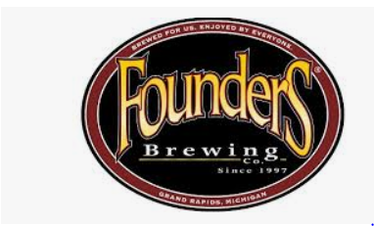
US BEER TREND
LIENG & RICHARDSON, LLP

Slide 2
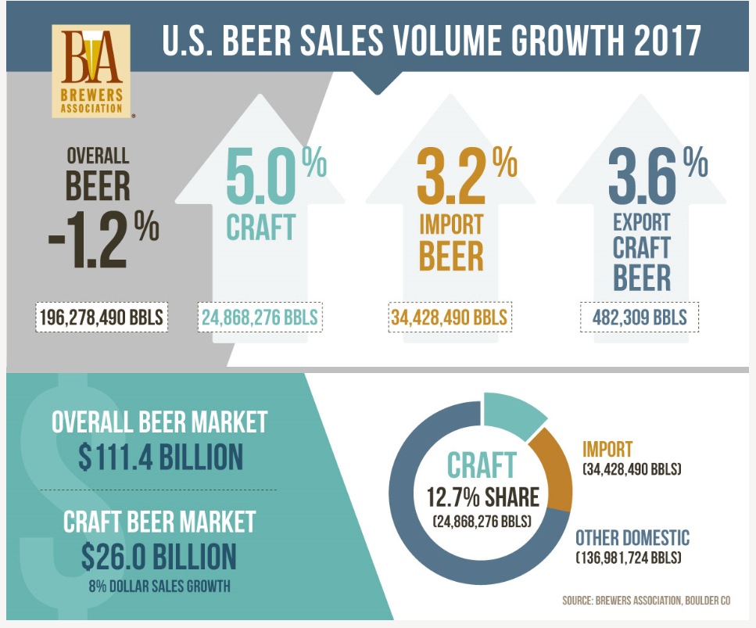
BREWERS ASSOCIATION FOR SMALL AND INDEPENDENT CRAFT BEERS
Overall U.S. beer volume sales were down
1% in 2017
Craft beer sales continued to grow at a rate of
5% by volume.
Craft retail sales increased 8%, up to $26.0 Billion
Craft accounts for more than 23% of the $114 billion
U.S. beer markert
https://www.brewersassociation.org/statistics/national-beer-sales-production-data/

Slide 3
PURPOSE
Founders Brewery currently ranks as the No.1 craft brewery in can sales totaling $52 million in 2017
5.2 percent of 2017 sales growth came from new markets, and 62% of packaged volume (bottles vs.cans) are now in cans.
Lieng and Richardson, LLP was presented with data from the founders Mike Stevens and Dave Engbers to understand the patterns that would be helpful in pursuing new marketing opportunities.
Analysis
Identify the number breweries with each state
Determine the median alcohol by volume (ABV) and median bitterness (IBU) from each state
Identify the State(s) with the highest ABV and IBU content beer
Identify a potential linear trend between ABV and IBU

Slide 4
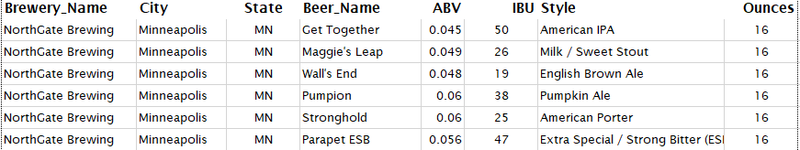
Data Review
Detected missing values
1005 out of 2410 (41.7%) didn’t have
have an IBU value
62 out of 2410 (2.57%) did not have a
a ABV value
Occurrences of missing values eliminated

Slide 5
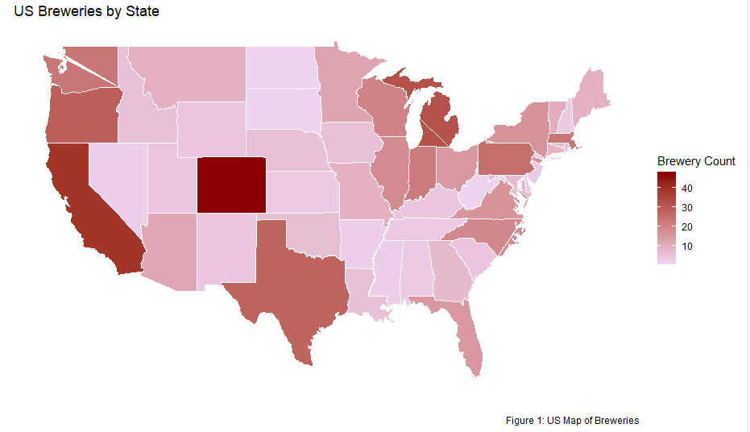
BREWERIES PRESENCE IN EACH STATE
Highest States Presence - Colorado with 47 and California 39
Top 5 states accounts for 31% of all US Breweries
Lowest States Presence

Slide 6
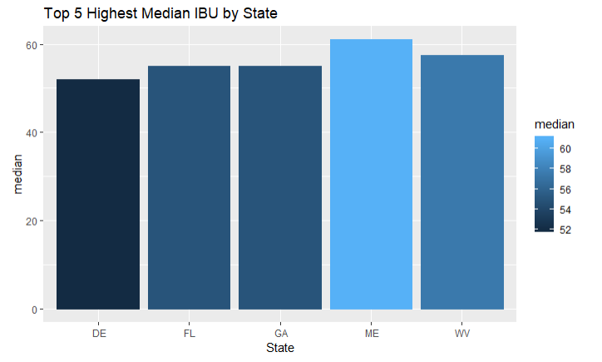
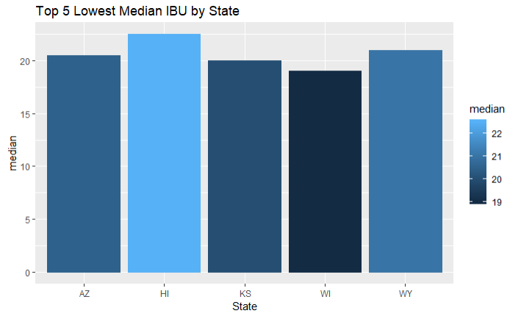
MEDIAN IBU FOR U.S HIGHEST AND LOWEST STATES
Median IBU by State
Range between 10 to 82 – Highest 5
Range between 7 to 110 – Lowest 5
Greater variation in the median IBU for lowest 5 states
``

Slide 7
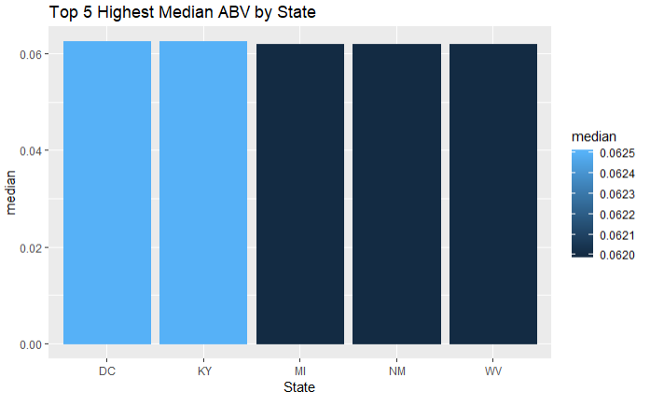
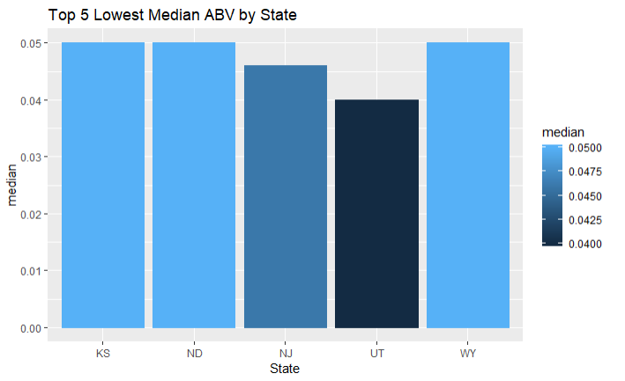
MEDIAN ABV FOR U.S HIGHEST AND LOWEST STATES
Median by ABV
Range between 0.038 to 0.125 – Highest 5
Range between 0.039 to .099 – Lowest 5
Roughly same variation in the median ABV

Slide 8
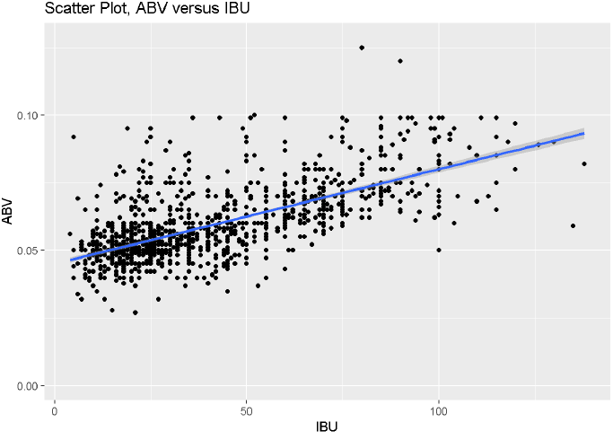
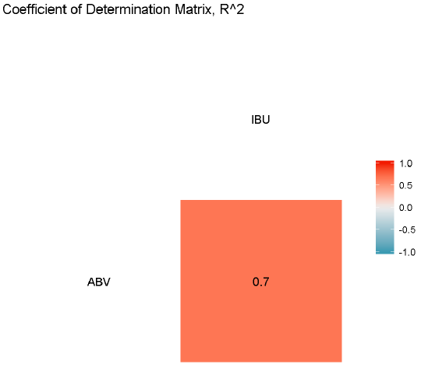
LINEAR TREND BETWEEN IBU AND ABV
-Scatter plot between ABV vs IBU, majority of the data points were concentrated 10-30 IBU with the corresponding ABV between 0.03 to 0.06 ABV. A correlation matrix plot on the right showed that coefficient of determination (R²) of 0.7 or 70% of the response variable variation that is explained by the linear model

